Slide 1
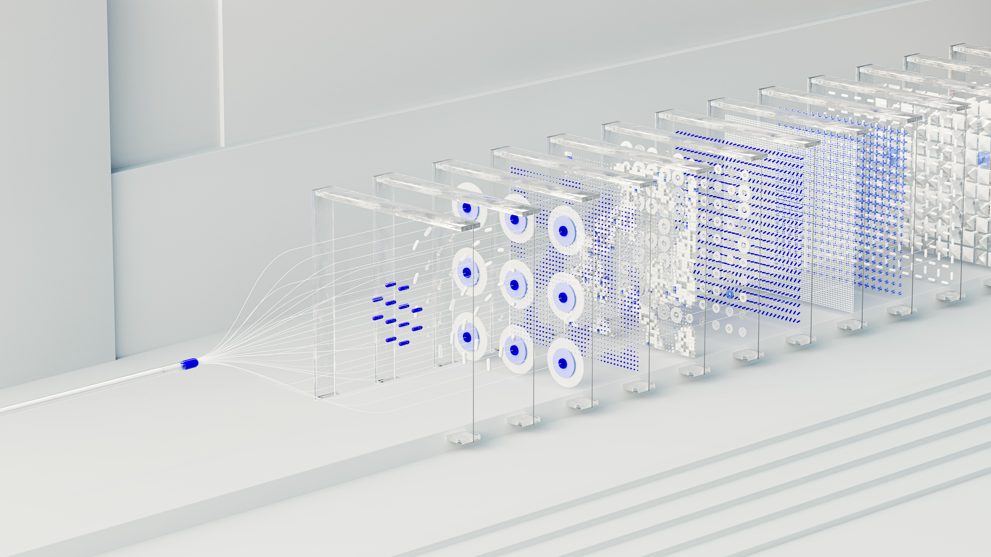

INTRUDER DETECTION
IN SUREVILANCE
Under Guidance of :
Dr.Rajesh Babu
Head of Department
Dept. of Computer science and Engineering
Tamilnadu college of Engineering
Coimbatore
Team members:
Abineeth TM (22CSO4)
Basil V Mathew (22CS08)
Inbarasu M (22CS21)
Koushick G V (22CS29)

Slide 2
INTRODUCTION
In today's world, security is a top priority, and surveillance systems play a crucial role in maintaining it. However, traditional surveillance systems often rely on human monitoring, which can be prone to errors and inefficiencies. Our project aims to address this issue by developing an intelligent surveillance system that can detect individuals, recognize their faces, and identify their dress code in realtime, enabling swift action against potential security breaches. The proposed system has the potential to revolutionize the field of surveillance and security, providing a more effective and efficient solution for modern security challenges.

Slide 3
ABSTRACT
This project develops an intelligent surveillance system that detects individuals, recognizes their faces, and identifies their dress code in realtime, enabling swift action against potential security breaches. The system uses computer vision and deep learning techniques, including face detection, individual detection, and dress code recognition, to automate surveillance and reduce human error. By integrating these techniques, the system provides a robust and efficient solution for security personnel to monitor and respond to potential threats. The proposed system has the potential to enhance security measures in various settings, including public spaces, offices, and border control points, making it a valuable contribution to the field of surveillance and security.

Slide 4
Technology used
Language : python
GUI : tkinder
video processing : cv2
face recognition : face_recoginition / numpy
object detection : tensor flow
image processing : pillow
data storage : pickle / json /SQLite
file management : os / pickle
alerts : smtplib

Slide 5
Literature Survey
Face Detection: MTCNN, RetinaFace, and Haar Cascade are state of theart techniques for face detection in surveillance systems.
Individual Detection: YOLOv3/v4, Faster RCNN, and SSD are popular object detection algorithms used for individual detection.
Dress Code Recognition: Deep-Fashion, Clothing-Net, and Transfer Learning approaches are used for dress code recognition.
Research Gap: Limited studies combine face detection, person detection, and dress code recognition in real time CCTV streams, highlighting the need for an integrated system.
Key Takeaway: Our project will leverage MTCNN/YOLOv3 for detection and finetuned CNNs for dress code, addressing realtime performance and robustness to CCTV constraints.

Slide 6
Existing System
Security mainly relies on ID cards, RFID, or manual verification
CCTV cameras are monitored manually by security personnel
Biometric systems (fingerprint / RFID) are limited to entry points
Face recognition systems (commercial) are costly and cloud-dependent
No automatic intruder detection mechanism
No verification of dress code compliance
No visual check for ID card presence
High dependence on human supervision
Prone to human error, card misuse, and delayed response
Limited automation, scalability, and customization

Slide 7
Proposed system
An automated security system using computer vision and AI
Face recognition to identify authorized employees
Intruder detection for unknown or unauthorized individuals
Employee face enrollment and secure data storage
Dress code detection (e.g., shirt / T-shirt classification)
ID card presence detection (visual check only)
Real-time monitoring using camera feed
Automatic alerts and logging of intruder events
Windows-based application with user-friendly GUI
Offline, cost-effective, and scalable solution

Slide 8
FLOW CHART
Authentication
Main UI
Live Feed from Input
Exisiting Video
Live
Re analyse
Video Proccessor
Cache /
Temp data storage
Video Analyser
Data model/
User datas
output
Video output
Log data

Slide 9
Usage of Project in Real-Time Environment
Office & Corporate Buildings – Automated employee identification and intruder detection
Restricted Areas – Labs, data centers, server rooms, and control rooms
Educational Institutions – Secure access to staff-only zones
Industrial Facilities – Monitoring entry compliance with dress code rules
Hospitals & Research Centers – Controlled access to sensitive departments
Government Offices – Enhanced security with minimal human supervision
Small & Medium Enterprises (SMEs) – Cost-effective offline security solution
Attendance & Monitoring Support – Employee presence verification
Security Auditing – Intruder image capture and event logging

Slide 10
Core Research Papers
Doc ID / Link | Abstract | Additional Notes
2019_IEEE-ANTShttps://dspace.nitrkl.ac.in | Video-based real-time intrusion detection system using deep learning methods (YOLO, SORT) on edge devices for automated surveillance and intruder alerts. | ⭐ Most Relevant:Directly combines video processing + intrusion detection. Uses YOLO for object detection and SORT for multi-object tracking. Real-time edge device implementation.
IEEE-7852676ieeexplore.ieee.org | Intrusion detection of specific area based on video using Gaussian Mixture Model (GMM) improvements for background subtraction and object detection/tracking. | ⭐ Highly Relevant:Uses GMM for background modeling. Area-specific detection. Good for region-based intrusion alerts in surveillance zones.
IEEE-10134400ieeexplore.ieee.org | Intrusion detection using camera and alert management. Image processing with Sum of Absolute Difference (SAD), camera-based motion detection and automated alerting. | Relevant:SAD method for motion detection. Good for simple frame-to-frame difference. Alert system integration.
IEEE-10370984ieeexplore.ieee.org | Intelligent intruder detection system for surveillance rover using neural-network-based detection on mobile platform with autonomous movement capabilities. | Advanced:Mobile/drone-based detection. Neural networks for classification. Good for moving camera scenarios.

Slide 11
Conclusion
Developed an automated security system using computer vision and AI
Successfully integrates face recognition for employee identification
Detects intruders in real time with image logging
Verifies dress code compliance and ID card presence
Reduces dependency on manual monitoring
Works as an offline, cost-effective Windows application
Suitable for small to medium secure facilities
Can be extended with GPU acceleration, liveness detection, and multi-camera support
The proposed system enhances security by combining identity verification with compliance monitoring in real-time.

Slide 12
References
https://en.wikipedia.org/wiki/Facial_recognition_system
https://en.wikipedia.org/wiki/Computer_vision
https://en.wikipedia.org/wiki/Object_detection
https://en.wikipedia.org/wiki/Convolutional_neural_network
https://en.wikipedia.org/wiki/Biometrics
https://docs.opencv.org
https://github.com/ageitgey/face_recognition

